Slide 1

UNICHAT
Making Messaging Easy Again

Slide 2
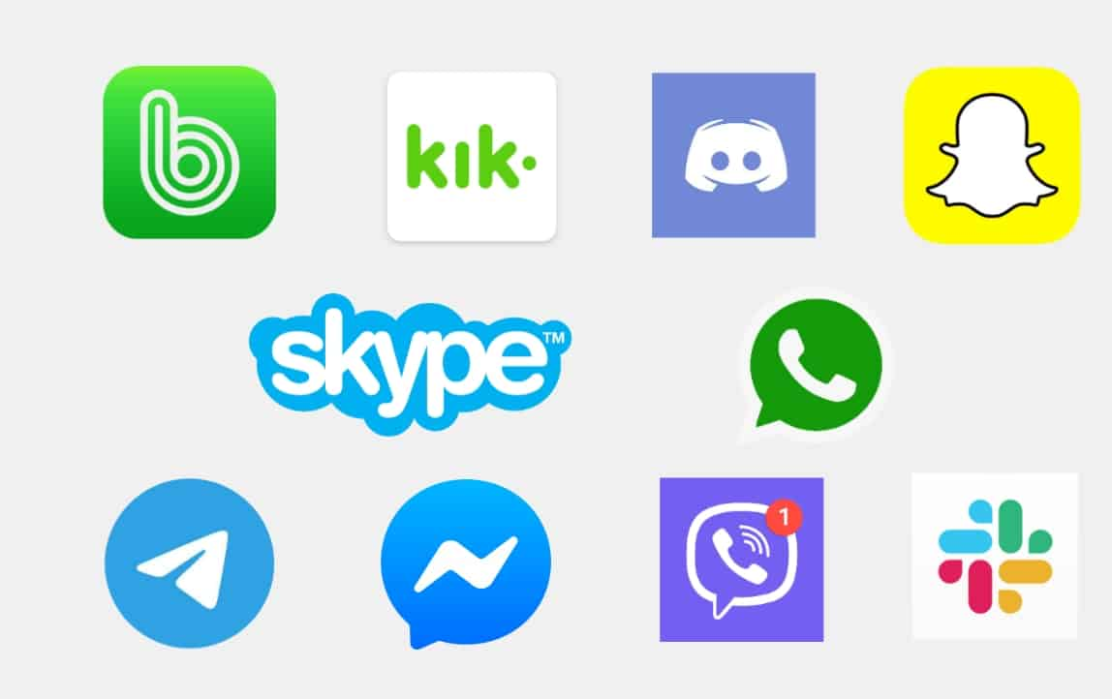
What do you use to communicate?

Slide 3


Why do you need so many different clients?

Slide 4

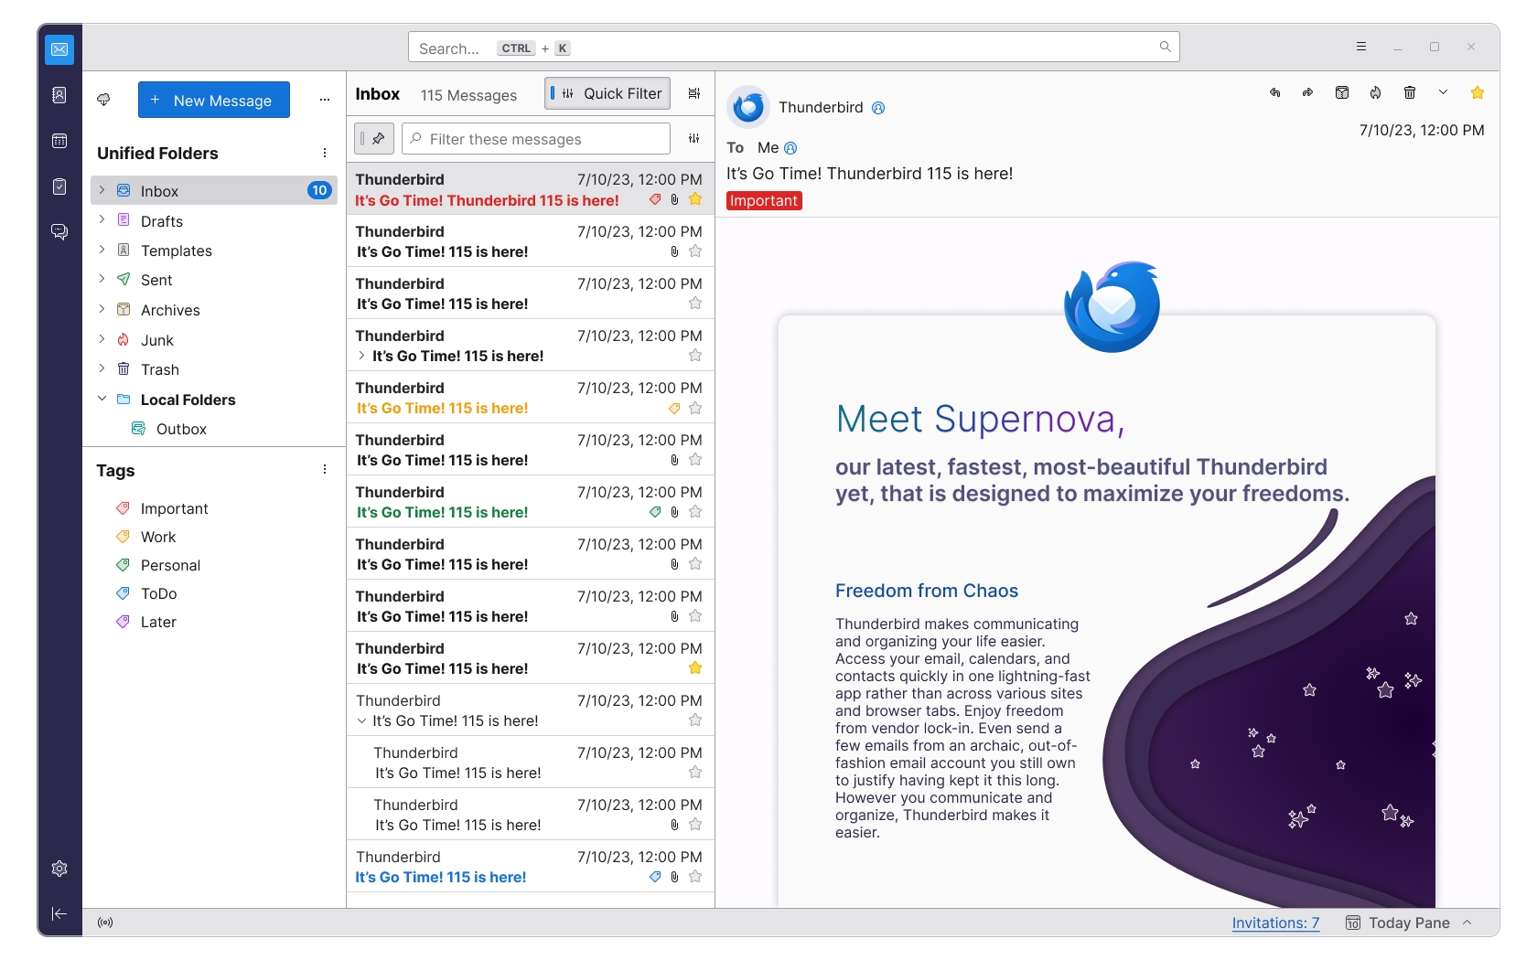
The Idea

Slide 5
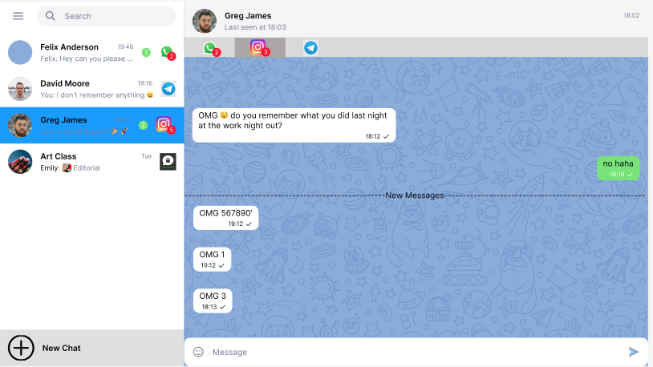
The Solution
One Client to rule them all
Allows you to keep track of your messages

Slide 6
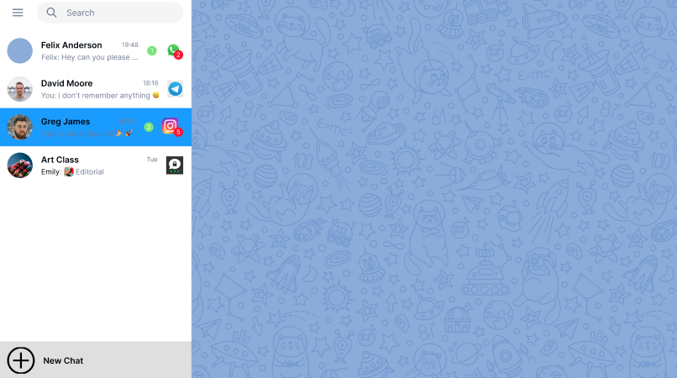
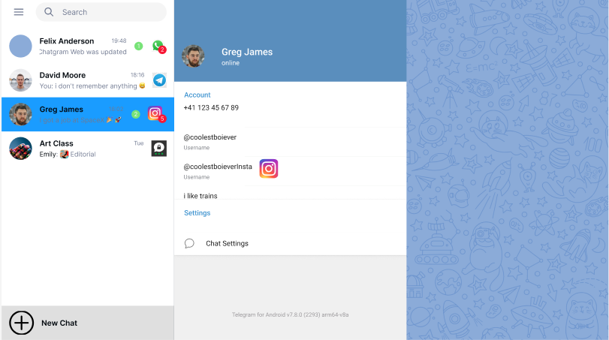
Starting point
One Client that allows the User to manage what account corresponds to their friends

Slide 7




Where we are now

Slide 8
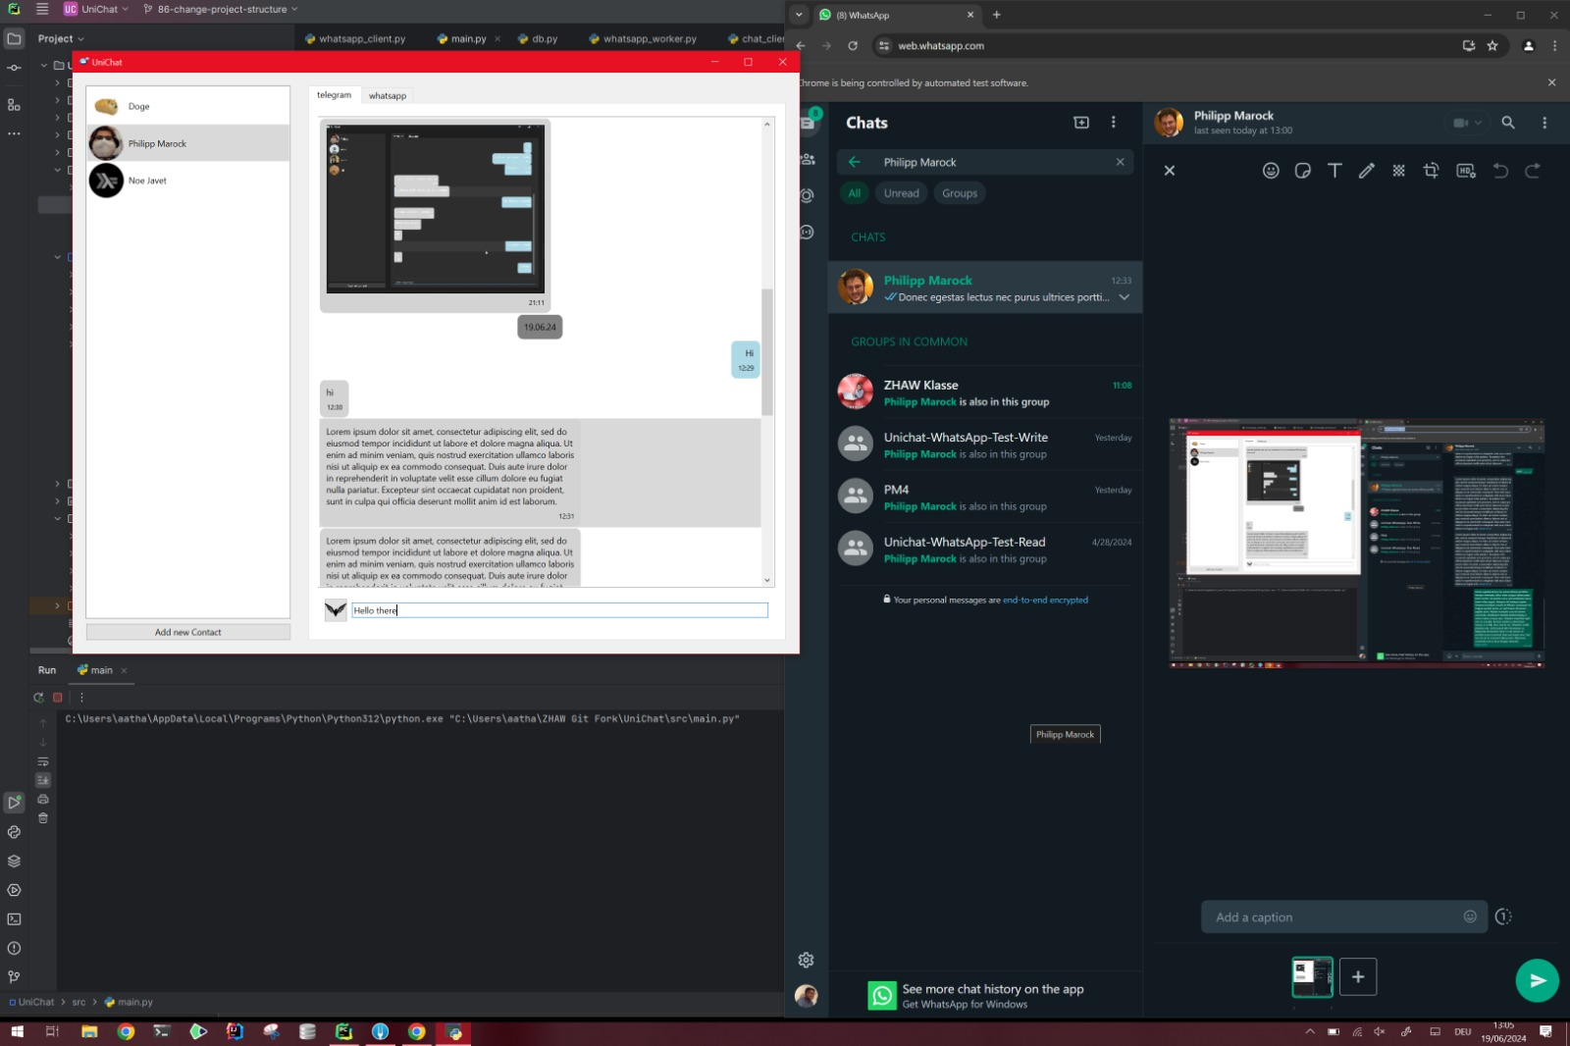
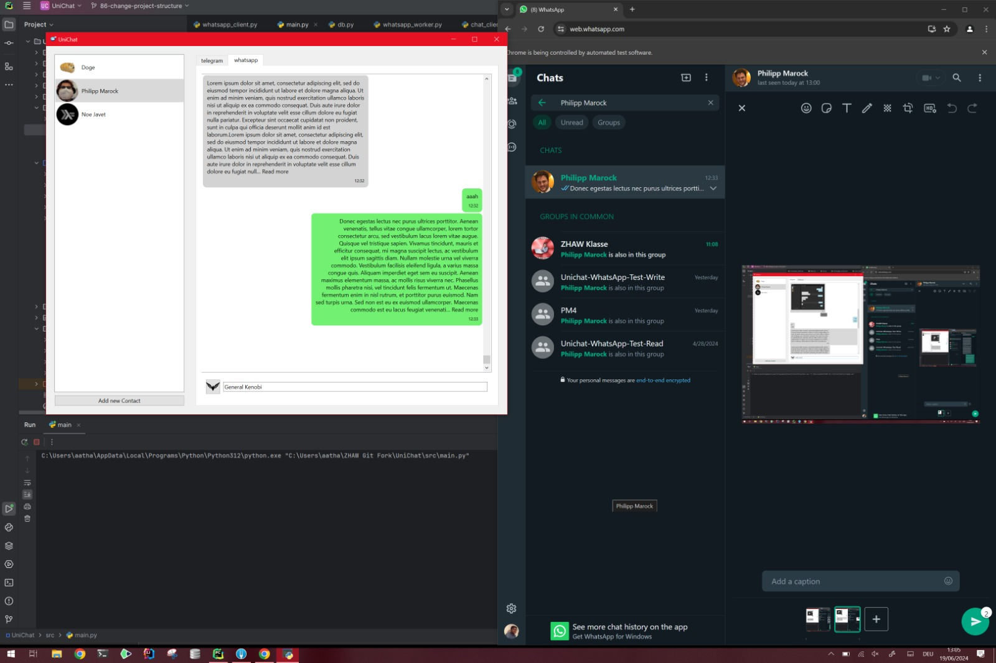
How it looks

Slide 9

What is implemented
Telegram
Fully implemented
Fully integrated
WhatsApp
Fully implemented
Fully integrated
Discord
Fully implemented
Instagram
Fully implemented

Slide 10


Problems
Telegram is great
Meta is not great

Slide 11

API and Webscraping
Telegram has an API that allows for creating a Client
WhatsApp and Instagram are implemented through Web-Scraping using Selenium
Meta constantly changes their Websites. These changes break our webscraping.

Slide 12

Webscraping
We use Selenium a Website “Testing” Tool.
Selenium allows us to get Website-Elements into Python
Selenium automates your browser to do certain actions
Can run in the background
Could be detected and banned by the website provider
Slows down our processes
Probably legal, no known law suits

Slide 13

Issues
Constantly changing Websites
Slow Data Transfer to our program due to wait times
Certain features are not supported
Media
Stickers

Slide 14

Again Telegram is great
Telegram has its own open API
It just Works

Slide 15
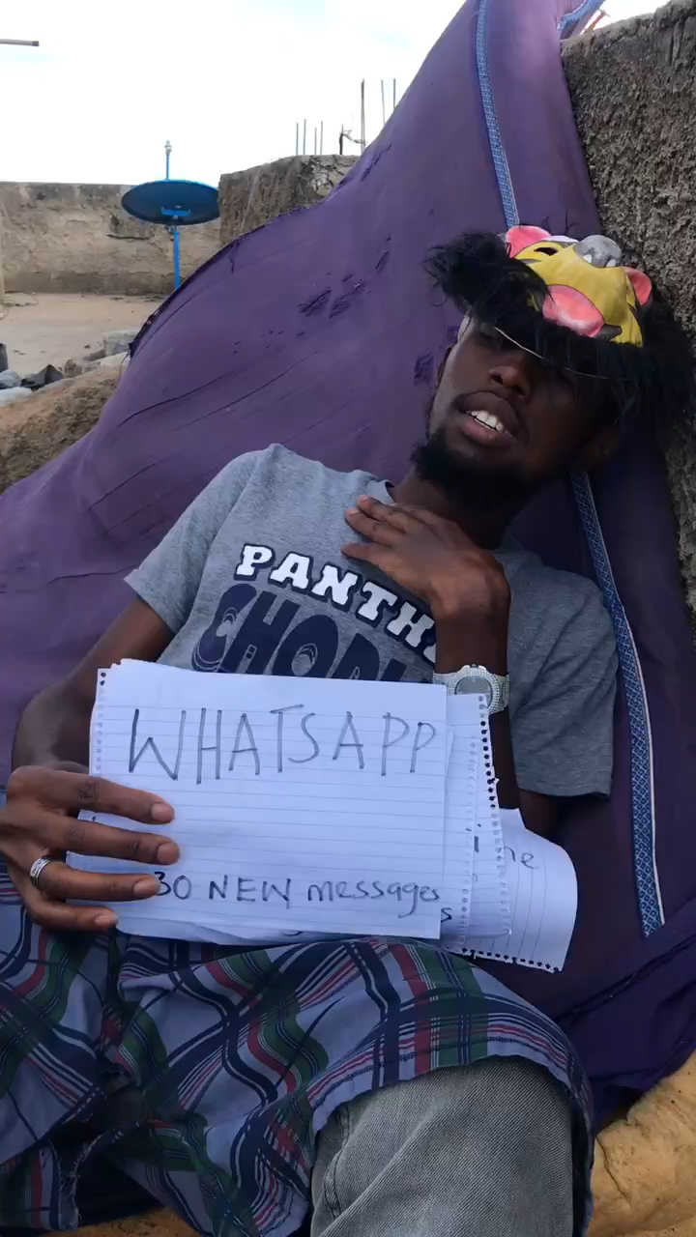

Slide 16

Small Demo

